Slide 1
ESCAP Academic Division and European Child and Adolescent Psychiatry
Johannes Hebebrand
Department of Child and Adolescent Psychiatry, Psychosomatics and Psychotherapy
University of Duisburg-Essen

Slide 2
Why Focus on European Child and Adolescent Psychiatry?
European tradition in child and adolescent psychiatry of utmost importance
historical roots
European conceptualisation of this specialty
traditional focus on psychotherapy
traditional focus on childrens rights and societal issues
preservation requires active engagement
we live in a competitive world

Slide 3
Why think European?
Benefits of European unity and diversity
similar problems approached in different ways
solid comparisons valuable for practical clinical work
major differences indicate the need for reflection and clinical research
perception/understanding that different paths towards the same goal can be sucessful
awareness of societal/cultural influences on the development of children and adolescents
research funding via national and European agencies

Slide 4
Why Cooperation between ESCAP and ECAP?
ECAP:
valuable input (guidelines, European clinical and basic research)
attractive to European readership
ESCAP:
Joint „voice“ a must
publication forum
European societies for other specialties have official journals
„corporate identity“

Slide 5
ESCAP Research Academy
Originally established by Helmut Remschmidt (Research Seminars)
Reinitiated in 2015
Meetings in Madrid, Geneva, Vienna, and Maastricht
Funding: 5000 Euros each from ESCAP and Johannes Hebebrand
Goals:
Scientific training
Attractiveness of an academic career, scientific offspring
Establishment of a large international network of clinician-scientists

Slide 6
ESCAP Research Academy Meetings 2015-2022
Madrid 2015
Grant writing
Stephan Eliez, Kent Hung, Christofer Correll, Henk Linse, Bruno Fallissard,
Geneva 2017
Development after early life adversity
Edmund Sonuga-Barke, Gordon Harold, Carmen Sandi, Doron Gothelf, Johannes Hebebrand
Vienna 2019
Novel technologies for diagnostic assessment and treatment in child and adolescent psychiatry: history, current development and future perspectives
Lucia Valmaggia, Ulrich Reininghaus, Frank Verhulst, Johannes Hebebrand
Virtual meeting 2020
No
Marie Schaer, Edna Grünblatt, Brenda Vincenzi, Thomas Wiese, Johannes Hebebrand
Online ESCAP/UEMS/EFPT Training Day 2021
Genetic testing, clinical high risk for psychosis, anorexia nervosa
Franziska Degenhardt, Marco Armando, Johannes Hebebrand
Maastricht 2022
New perspectives for research and clinical practice in eating disorders
Janet Treasure, Esther Via Virgili, Bruno Fallissard, Johannes Hebebrand
Paul Klauser, Alexis Revet and Johannes Hebebrand

Slide 7
ESCAP Academic Division
Successful publication of two ESCAP CovCAP surveys of heads of academic departments to assess the perceived (April/May 2020; Feb/March 21) impact of the COVID-19 pandemic on child and adolescent psychiatric services
2020: 20 countries, 82 respondents
2021: 22 countries, 72 respondents
Scheduled survey to assess the initial assessment of patients initially referred to outpatient units (Alexis Revet, Paul Klauser and former attendees of ESCAP Research Academy)
Revet et al., ECAP 2020, 2021;
2020: doi: 10.1007/s00787-020-01699-x; 2021: doi: 10.1007/s00787-021-01851-1)

Slide 8
ESCAP Practice Guideline for autism: A summary of evidence-based recommendations for diagnosis and treatment
Fuentes J, Hervas A, Howlin P & ESCAP ASD Working Group
Across Europe, there is increased awareness of the frequency and importance of autism spectrum disorder (ASD), which is now recognised not only as a childhood disorder but as a heterogeneous, neurodevelopmental condition that persists throughout life. Services for individuals with autism and their families vary widely, but in most European countries, provision is limited. In 2018, European Society of Child and Adolescent Psychiatry (ESCAP) identified the need for a Practice Guidance document that would help to improve knowledge and practice, especially for individuals in underserviced areas. The present document, prepared by the ASD Working Party and endorsed by the ESCAP Board on October 3, 2019, summarises current information on autism and focuses on ways of detecting, diagnosing, and treating this condition.
Fuentes et al., ECAP 30, 961–984, 2021

Slide 9
Training Initiatives in Collaboration with UEMS and EFPT
A new European Curriculum Framework for training and education CAP. Deschamps P, et al. Eur Child Adolesc Psychiatry. 2022 PMID: 35695946
Crossing borders while in lockdown: reflections from the European Federation of Psychiatric Trainees virtual forum 2020.Seker A, et al. Eur Child Adolesc Psychiatry. 2022. PMID: 32833061
Potential effects of Covid-19 on training in CAP: the balance after a year. Deschamps P, et al. Eur Child Adolesc Psychiatry. 2021. PMID: 34175986
Training for child and adolescent psychiatry in the twenty-first century. Deschamps P, Hebebrand J, Jacobs B, Robertson P, Anagnostopoulos DC, Banaschewski T, Birkle SM, Dubicka B, Falissard B, Giannopoulou I, Hoekstra PJ, Kaess M, Kapornai K, Klauser P, Revet A, Schröder CM, Seitz J, Şeker A, Signorini G. Eur Child Adolesc Psychiatry 2020 PMID: 31950371

Slide 10
Editorial Statement 2022
Dear colleagues,
European Child and Adolescent Psychiatry (ECAP) condemns the brutal invasion of Ukraine. We as Editors devote intense efforts to children's health worldwide. Our passion to improve children’s wellbeing drives our daily clinical work, research activities, and editorial commitments. We had hoped that the health catastrophe of the SARS-CoV-2 pandemic would have been able to demonstrate that our planet and our humanity are a unity, and if one suffers, all of us do. However, even before this pandemic reaches an end, the power aspirations of a restricted group of individuals are now perpetrating destruction, pain, and death. As health professionals devoted to children, we cannot remain untouched by such atrocities.
Therefore, we urge all Russian and Belarusian authorities to immediately stop the injustice and aggression that directly and severely harm children and adolescents in Ukraine. In addition, such a stop would minimize the negative effects on the mental health of many children, adolescents and their families throughout all of Europe.
The ECAP Editors Franziska Degenhardt, Doron Gothelf, Johannes Hebebrand (Editor-in-Chief), Pieter Hoekstra (Associate Editor), Michael Kaess (Associate Editor), Julian Koenig, Maria Melchior, Nadia Micali, Carmen Moreno, Veit Roessner

Slide 11
ECAP Focused Issues and Article Collections
Type | Issue | Year | Title | Managing Editor
Article collection | - | 2022 | Child and Adolescent Psychiatry in the post-COVID era –lessons learned and consequences for the future | Michael Kaess, Pieter Hoekstra
Focused Issue | 3 | 2022 | Update of the European clinical guidelines for Tourette Syndrome and other tic disorders | Veit Roessner Pieter Hoekstra
Focused Issue | 1 | 2020 | The European and Global Perspective on Training in Child and Adolescent Psychiatry
Focused Issue | 9 | 2018 | Conduct Disorder and Aggressive Behaviour in Children and Adolescents | C. Freitag, D. Boomsma, J. Glennon, B. Franke
Focused Issue | 4 | 2018 | Mental Health in Refugees | M. Hodes, D. Anagnostopoulos, N. Skokauskas
Focused Issue | 9 | 2017 | The Role of Nutrition in Child and Adolescent Onset Mental Disorders | J. Hebebrand, N. Lambregts-Rommelse

Slide 12
About this journal
European Child and Adolescent Psychiatry is Europe's only peer-reviewed journal entirely devoted to child and adolescent psychiatry. It aims to further a broad understanding of psychopathology in children and adolescents. Empirical research is its foundation, and clinical relevance is its hallmark.
European Child and Adolescent Psychiatry welcomes in particular papers covering neuropsychiatry, cognitive neuroscience, genetics, neuroimaging, pharmacology, and related fields of interest. Contributions are encouraged from all around the world.

Slide 13
Editorial Board
Editor-in-Chief
Johannes Hebebrand
Associate Editors
Pieter J. Hoekstra, The Netherlands
Michael Kaess, Switzerland
Editorial Board Members
Franziska Degenhardt, Germany
Bruno Fallisard, France
Doron Gothelf, Israel
Yong He, China
Julian Koenig, Germany
Maria Melchior, France
Nadia Micali, UK
Carmen Moreno, Spain
Veit Roessner, Germany
Argyris Stringaris, USA

Slide 14
Journal Usage, Visibility and Impact
Full-Text Article Requests 2019-2022
Totals
2016 | 295,076
2017 | 411,631
2018 | 510,873
2019 | 611,193
2020 | 808,684
2021 | 1,318,222

Slide 15
Journal Usage, Visibility and Impact
Top 10 Full-Text Article Requests 2021
Title | Author | Article Types | Year | Article Requests 2021
Impact of the COVID-19 pandemic on quality of life and mental health in children and adolescents in Germany OA | Ulrike Ravens-Sieberer et al. | Original Contribution | 2021 | 65,379
Why do children and adolescents (not) seek and access professional help for their mental health problems? A systematic review of quantitative and qualitative studies OA | Jerica Radez et al. | Review | 2021 | 28,660
Early motor signs of attention-deficit hyperactivity disorder: a systematic review OA | A. Athanasiadou et al. | Review | 2020 | 26,727
Parental experiences of homeschooling during the COVID-19 pandemic: differences between seven European countries and between children with and without mental health conditions OA | Lisa B. Thorell et al. | Original Contribution | 2021 | 23,204
Mostly worse, occasionally better: impact of COVID-19 pandemic on the mental health of Canadian children and adolescents | Katherine Tombeau Cost et al. | Original Contribution | 2021 | 17,047
Prevalence and socio-demographic correlates of psychological health problems in Chinese adolescents during the outbreak of COVID-19 | Shuang-Jiang Zhou et al. | Original Contribution | 2020 | 15,786
Families in the COVID-19 pandemic: parental stress, parent mental health and the occurrence of adverse childhood experiences—results of a representative survey in Germany OA | Claudia Calvano et al. | Original Contribution | 2021 | 13,094
Vulnerability and resilience in children during the COVID-19 pandemic | Winnie W. Y. Tso et al. | Original Contribution | 2020 | 13,011
Differentiating between ADHD and ASD in childhood: some directions for practitioners | Nanda Rommelse et al. | Editorial | 2018 | 12,980
Potential effects of “social” distancing measures and school lockdown on child and adolescent mental health | Vera Clemens et al. | Editorial | 2020 | 12,705

Slide 16
Journal Usage, Visibility and Impact
Read and Publish (Springer Compact) agreements
Full access to all Springer subscription journal content for the institutions/authors of these institutions
The open access publication fee is covered by the author’s institution (for more than 1,850 Springer hybrid journals)
Agreements with 21 countries
Benefits for authors
Higher visibility and greater impact: In Springer hybrid journals, open access articles are accessed 4 times more often on average, and cited 1.6 more times on average.
Easy compliance with mandates: Many funders require open access, and some take compliance into account when assessing future grant applications.
The copyright remains with the authors

Slide 17
Springer Nature Sustainable Development Goals Publishing Program
17 Sustainable Development Goals of the United Nations (UN) that aim to secure worldwide sustainable development in economic, societal and environmental spheres
Came into effect in January 2016, goals to be achieved by 2030
specific targets and indicators serve to assess the progress in achieving the 17 goals
Publications in ECAP contribute to SDG 3 „Good Health and Well-being“ (https://www.un.org/sustainabledevelopment/health/)
2022: 5 articles featured in Springer Nature’s Mental Health Awareness Month campaign There is one ECAP article featured in each of the following subfields: Children & Young Adults, Gender & LGBTQ+, Poverty and Mental Health, and two articles in Culture, Colonisation & Immigration.
2021:
2 articles featured in Springer Nature Suicide Prevention Campaign subfields “Psycho-social, Societal, and Cultural Influences” and “Mental Wellbeing and Resilience”
1 article featured in Springer Nature Climate Change & Health Campaign subfield “Environmental health & Direct climate impacts on health”

Slide 18
ESCAP and SpringerNature: Cooperation and Synergy
“Congress subscriptions”: 2 years personal online full-text access for ESCAP congress attendees since congress in 2013
ESCAP Communications: 3-4 articles per year published in regular issues of ECAP
ESCAP homepage featuring ECAP:
Article previews (directly submitted by authors)
Tables of content including links
ESCAP and Springer newsletters

Slide 19
Journal Development Overview
Submissions | 2018 | 2019 | 2020 | 2021 | 06/2022
Total Submitted | 490 | 563 | 758 | 714 | 304
Per month | 41 | 47 | 63 | 60 | 55
Total Decisioned | 461 | 543 | 746 | 703 | 284
Accept | 151 | 169 | 225 | 190 | 75
Reject | 310 | 374 | 521 | 513 | 209
Acceptance Rate | 33% | 31% | 30% | 27% | 26%
Rejection Rate | 67% | 69% | 70% | 73% | 74%
Articles published | 158 | 188 | 222 | 222 | -
Average Days to First Decision | 46 (31) | 49 (28) | 41 (13) | 43 (11) | 42 (12)
Average Days to Final Disposition Accept (Median) | 192 (168) | 205 (189) | 190 (172) | 188 (169) | 186 (172)
Average Days to Final Disposition Reject (Median) | 29 (5) | 31 (7) | 24 (6) | 30 (7) | 32 (7)
Decisions | 2018 |  | 2019 |  | 2020 |  | 2021 |  | 06/2022
Accept | 151 | 33% | 169 | 31% | 225 | 30% | 190 | 27% | 75 | 26%
Immediate Reject | 220 | 48% | 264 | 49% | 414 | 55% | 396 | 56% | 155 | 55%
Reject | 90 | 19% | 103 | 20% | 107 | 15% | 117 | 17% | 54 | 19%

Slide 20
Content and Quality
Origin of Submissions and Accepted Manuscripts
*sorted by “number of manuscripts accepted 2021” from large to small
Region | Number of Manuscripts Submitted |  |  | Number of Manuscripts Accepted*
 | 2019 | 2020 | 2021 | 2019 | 2020 | 2021
GERMANY | 36 | 55 | 41 | 12 | 24 | 28
UNITED KINGDOM | 45 | 80 | 66 | 25 | 27 | 26
NETHERLANDS | 36 | 32 | 38 | 18 | 15 | 18
SPAIN | 32 | 59 | 29 | 4 | 12 | 12
USA | 33 | 28 | 29 | 13 | 16 | 11
AUSTRALIA | 19 | 26 | 23 | 6 | 11 | 10
DENMARK | 9 | 24 | 10 | 6 | 12 | 9
FRANCE | 23 | 30 | 37 | 4 | 11 | 9
CANADA | 15 | 18 | 13 | 10 | 8 | 7
NORWAY | 16 | 16 | 20 | 8 | 9 | 7
SWEDEN | 23 | 28 | 13 | 7 | 15 | 7
CHINA | 59 | 91 | 102 | 7 | 9 | 6
TAIWAN | 19 | 18 | 35 | 5 | 5 | 6
ISRAEL | 8 | 16 | 12 | 3 | 4 | 5
ITALY | 24 | 36 | 28 | 6 | 11 | 5
AUSTRIA | 4 | 5 | 11 | 1 | 1 | 1
FINLAND | 16 | 8 | 13 | 6 | 4
Region | Number of Manuscripts Submitted |  |  | Number of Manuscripts Accepted*
 | 2019 | 2020 | Nov-2021 | 2019 | 2020 | 2021
BELGIUM | 10 | 7 | 6 | 4 | 4 | 3
BRAZIL | 17 | 14 | 25 | 9 | 4 | 3
SWITZERLAND | 7 | 14 | 11 | 4 | 5 | 3
JAPAN | 7 | 8 | 7 |  |  | 3
TURKEY | 37 | 46 | 31 |  | 2 | 2
GREECE | 3 | 2 | 3 |  | 1 | 1
POLAND | 3 | 5 | 10 |  | 1 | 1
QATAR | 1 | 1 |  |  |  | 1
CD |  | 1 |  |  |  | 1
ARGENTINA | 1
BOSNIA-HERZEGOVINA | 1
BANGLADESH | 1 |  | 1
BRUNEI DARUSSALAM | 1 | 1
CZECH REPUBLIC | 2 | 1 | 1
EGYPT | 7 | 5 | 7
HONG KONG | 3 | 10 | 7 | 1 | 1
CROATIA | 2 | 1 | 1 | 1 | 2
Notes:
Most submissions from:
CHINA, UNITED KINGDOM, Germany, Netherlands, France, Taiwan (for the first time in 2021)

Slide 21
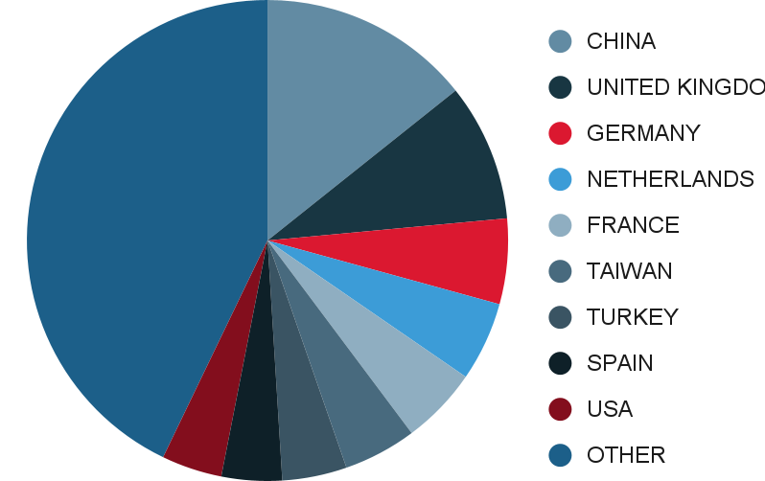
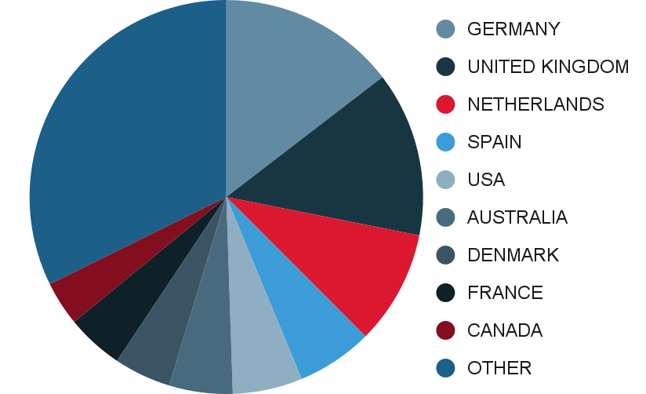
Content and Quality
Origin of Submissions and Accepted Manuscripts
Region | Number of Manuscripts Submitted |  |  | Number of Manuscripts Accepted*
 | 2019 | 2020 | 2021 | 2019 | 2020 | 2021
IRELAND | 3 | 4 | 9 | 2
INDIA | 1 | 2 | 8 | 1
IRAN | 12 | 15 | 17 | 2 | 1
ICELAND | 1
SOUTH KOREA | 14 | 8 | 17 | 1 | 3
LEBANON | 2 | 1 | 1
MONTENEGRO | 1
MALTA | 1
MALAYSIA | 1 | 1 | 1
NIGERIA | 3 |  |  | 1
NEW ZEALAND | 1 |  |  | 1
OMAN | 1
PAKISTAN | 1 | 1 | 3
PORTUGAL | 5 | 8 | 5 |  | 2
ROMANIA | 3 | 1 | 3
OTHER REGIONS | 9 | 30 | 23 | 1 | 4
Total | 576 | 756 | 714 | 169 | 224 | 192
*sorted by “number of manuscripts accepted 2021” from large to small
Top 10 countries submissions / acceptances 2021

Slide 22
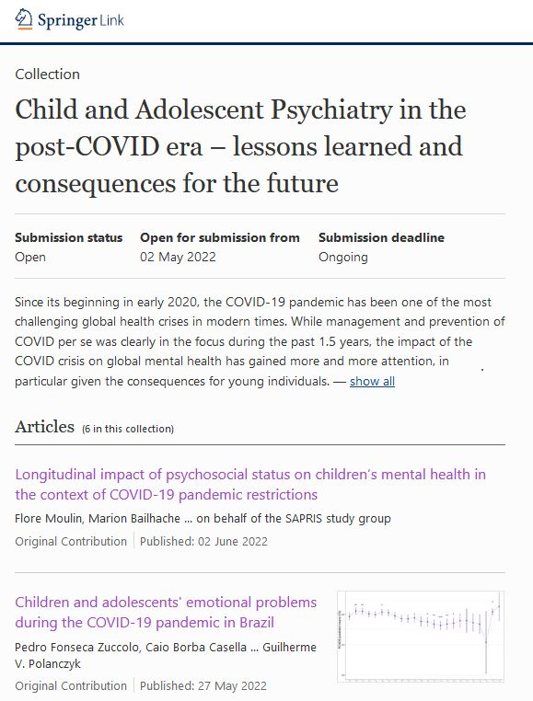

Slide 23
Impact Factor Development
Category Name | 2016 | 2017 | 2018 | 2019 | 2020
Pediatrics (science) | 12/121 | 9/124 | 8/124 | 8/128 | 10/129
Psychiatry (science) | 48/142 | 43/142 | 42/142 | 38/155 | 42/156
Psychiatry (social science) | 29/139 | 32/142 | 28/142 | 24/141 | 27/143
Psychology, developmental (social science) | 14/70 | 13/73 | 11/74 | 7/77 | 12/78

Slide 24
Impact Factor Development
Top 8 articles published in 2018-2019 cited in 2020
Title | Author | Article Type | Year | Cites in 2020
Sustained effects of neurofeedback in ADHD: a systematic review and meta-analysis (Open Access) | Van Doren et al. | Review | 2019 | 32
Prevalence of mental disorders in young refugees and asylum seekers in European Countries: a systematic review (Open Access) | Kien et al. | Review | 2019 | 27
Mental health problems of Syrian refugee children: the role of parental factors | Eruyar et al. | Original Contribution | 2018 | 24
Sex differences in predicting ADHD clinical diagnosis and pharmacological treatment (Open Access) | Mowlem et al. | Original Contribution | 2019 | 23
Advancing the study of sluggish cognitive tempo via DSM, RDoC, and hierarchical models of psychopathology | Becker & Willcutt | Review | 2018 | 19
Systematic review of meditation-based interventions for children with ADHD | Evans et al. | Review | 2018 | 16
Incidence of psychiatric disorders among accompanied and unaccompanied asylum-seeking children in Denmark: a nation-wide register-based cohort study | Norredam et al. | Original Contribution | 2018 | 15
The impact of maternal prenatal and postnatal anxiety on children's emotional problems: a systematic review (Open Access) | Becker et al. | Original Contribution | 2019 | 15

